Slide 1

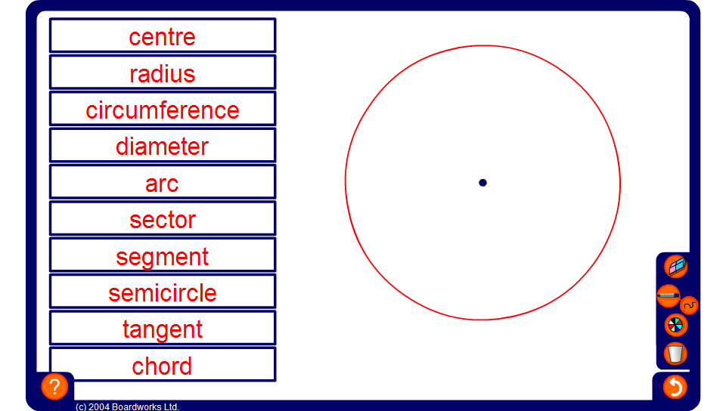


Naming the parts of a circle
Notes:
Use the activity to review the names of circle parts.
The two most commonly confused parts are segments and sectors. This can be remembered by thinking of a sector of cake (they both contain the letter c).

